Slide 1
Non-Linear Data Structure Graph

Slide 2
Graphs
What is Graph?
Representation of Graph
Matrix representation of Graph
Linked List representation of Graph
Elementary Graph Operations
Breadth First Search (BFS)
Depth First Search (DFS)
Spanning Trees
Minimal Spanning Trees
Shortest Path

Slide 3
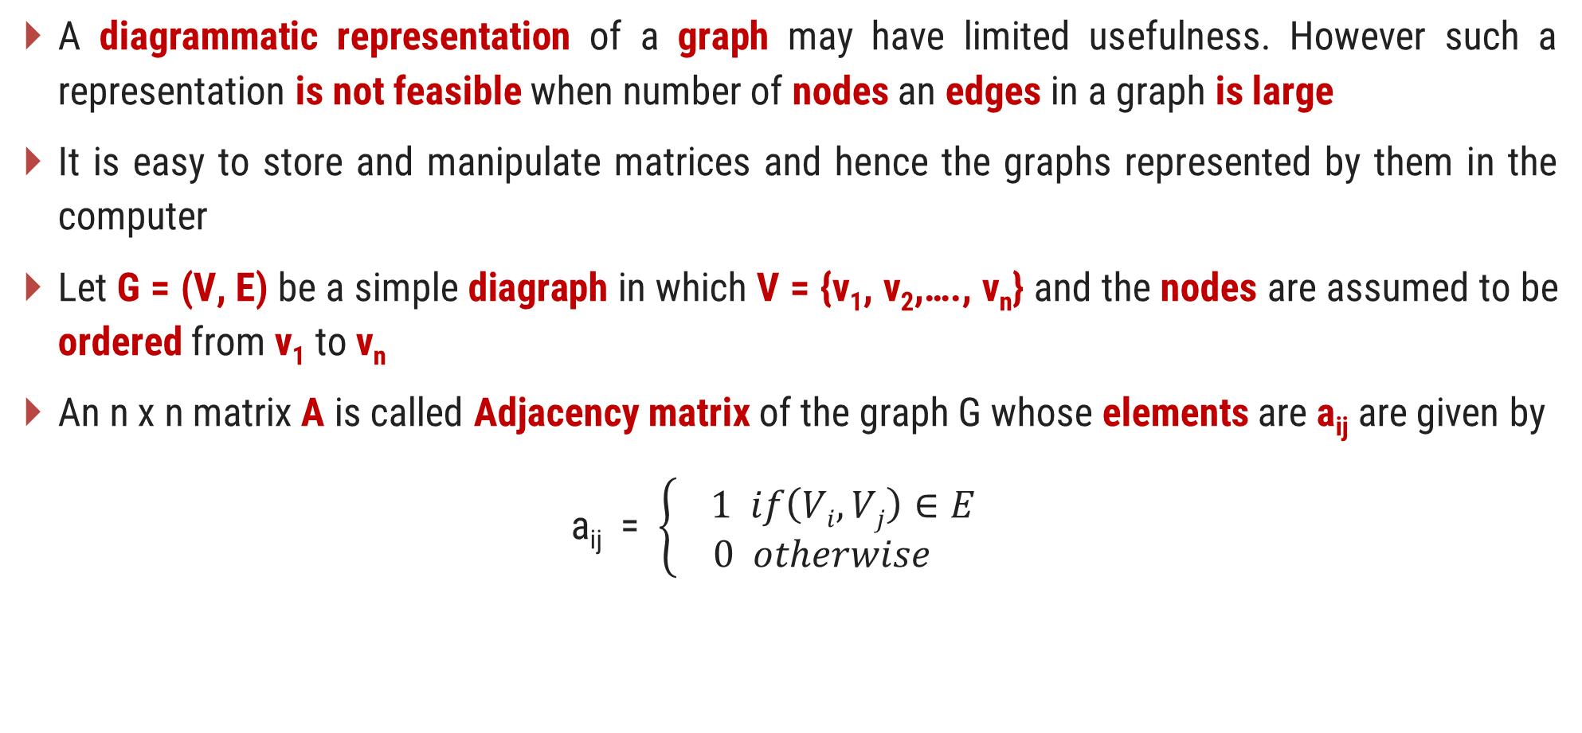
Adjacency matrix
A diagrammatic representation of a graph may have limited usefulness. However such a representation is not feasible when number of nodes an edges in a graph is large
It is easy to store and manipulate matrices and hence the graphs represented by them in the computer
Let G = (V, E) be a simple diagraph in which V = {v₁, v₂,…., v_{n}} and the nodes are assumed to be ordered from v₁ to v_{n}
An n x n matrix A is called Adjacency matrix of the graph G whose elements are a_{ij} are given by
a_{ij} = $\left\{\begin{aligned}1 if\left(Vi, Vj\right)∈E \\ 0 otherwise \end{aligned}\right.$

Slide 4
Adjacency matrix
An element of the adjacency matrix is either 0 or 1
Any matrix whose elements are either 0 or 1 is called bit matrix or Boolean matrix
For a given graph G =m (V, E), an adjacency matrix depends upon the ordering of the elements of V
For different ordering of the elements of V we get different adjacency matrices.
V₁
V₄
V₁
V₂
V₃
V₄
V₁
0 | 1 | 0 | 1
1 | 0 | 0 | 0
1 | 1 | 0 | 1
0 | 1 | 0 | 0
A =
V₂
V₃
V₄
V₂
V₃

Slide 5
Adjacency matrix
V₁
V₄
V₁
V₂
V₃
V₄
V₁
0 | 1 | 0 | 1
1 | 0 | 0 | 0
1 | 1 | 0 | 1
0 | 1 | 0 | 0
A =
V₂
V₃
V₄
V₂
V₃
The number of elements in the i^{th} row whose value is 1 is equal to the out-degree of node V_{i}
The number of elements in the j^{th} column whose value is 1 is equal to the in-degree of node V_{j}
For a NULL graph which consist of only n nodes but no edges, the adjacency matrix has all its elements 0. i.e. the adjacency matrix is the NULL matrix

Slide 6
Power of Adjacency matrix
1 | 1 | 0 | 1
1 | 1 | 0 | 0
2 | 2 | 0 | 1
0 | 1 | 0 | 1
0 | 1 | 0 | 1
1 | 0 | 0 | 0
1 | 1 | 0 | 1
0 | 1 | 0 | 0
1 | 1 | 0 | 0
0 | 1 | 0 | 1
1 | 2 | 0 | 1
1 | 0 | 0 | 0
A³ =
A =
A² = A x A =
1 | 2 | 0 | 1
1 | 1 | 0 | 1
2 | 3 | 0 | 2
1 | 1 | 0 | 0
A⁴ =
Entry of 1 in i^{th} row and j^{th} column of A shows existence of an edge (V_{i}, V_{j}), that is a path of length 1
Entry in A² shows no of different paths of exactly length 2 from node V_{i} to V_{j}
Entry in A³ shows no of different paths of exactly length 3 from node V_{i} to V_{j}

Slide 7

Path matrix or reachability matrix
Let G = (V,E) be a simple diagraph which contains n nodes that are assumed to be ordered.
A n x n matrix P is called path matrix whose elements are given by
$$P_{ij}=\left\{\begin{aligned}1,if there exists path from node V_{i} to V_{j} \\ &0, otherwise \end{aligned}\right.$$

Slide 8
Adjacency List Representation
0
4
1
2
3
0
1
2
3
4
1
2
3
4
0
3
0
3
4
0
1
2
4
0
2
3

Slide 9
Graph Traversal
Two Commonly used Traversal Techniques are
Depth First Search (DFS)
Breadth First Search (BFS)

Slide 10
Depth First Search (DFS)
It is like preorder traversal of tree
Traversal can start from any vertex V_{i}
V_{i} is visited and then all vertices adjacent to V_{i} are traversed recursively using DFS
DFS (G, 1) is given by
✓
1
Step 1: Visit (1)
Step 2: DFS (G, 2)
DFS (G, 3)
DFS (G, 4)
DFS (G, 5)
DFS (G, 2):
Step1: Visit(2)
Step 2: DFS (G, 6)
✓
2
5
✓
✓
3
✓
4
DFS (G, 6):
Step1: Visit(6)
Step 2: DFS (G, 3)
DFS (G, 8)
✓
6
✓
7
✓
DFS of given graph starting from node 1 is given by
8
1
2
6
3
8
7
4
5

Slide 11
Depth First Search (DFS)
✓
A
✓
B
C
✓
M
N
O
✓
D
✓
E
F
✓
G
✓
R
Q
P
H
✓
A
B
D
H
E
C
F
G
✓
A
✓
✓
B
✓
C
E
A
B
D
C
F
E
✓
D
F
✓

Slide 12
Breadth First Search (BFS)
This methods starts from vertex V₀
V₀ is marked as visited. All vertices adjacent to V₀ are visited next
Let vertices adjacent to V₀ are V₁, V₂, V₂, V₄
V₁, V₂, V₃ and V₄ are marked visited
All unvisited vertices adjacent to V₁, V₂, V₃, V₄ are visited next
The method continuous until all vertices are visited
The algorithm for BFS has to maintain a list of vertices which have been visited but not explored for adjacent vertices
The vertices which have been visited but not explored for adjacent vertices can be stored in queue

Slide 13
Breadth First Search (BFS)
✓
✓
A
✓
1
✓
2
5
✓
B
✓
C
✓
✓
✓
3
4
✓
D
✓
E
F
✓
G
6
✓
7
✓
8
H
✓
✓
1
|
2
3
4
5
|
6
7
|
8
A
| B C
| D E F G
| H
V₄
V₁
V₀| V₁ V₂ | V₄ V₆ V₃ | V₅
V₂
V₀
V₆
V₃
V₅

Slide 14
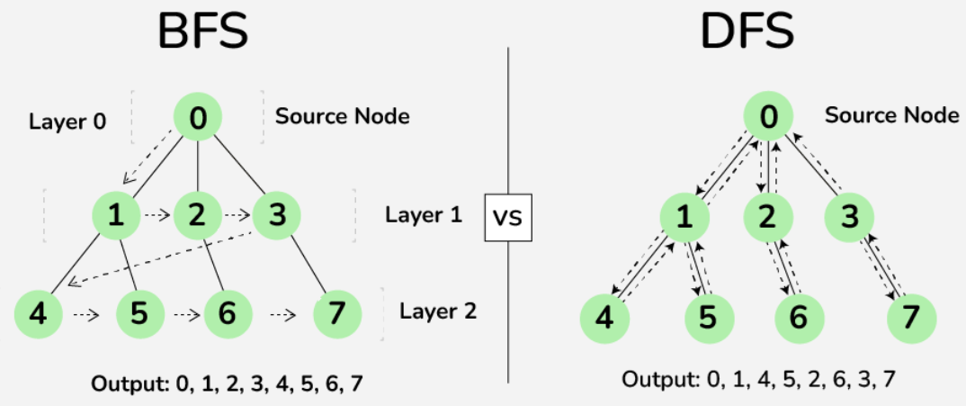
Difference

Slide 15
Write DFS & BFS of following Graphs
A B D H E C F G
A
M N O P Q R
B
C
A B C D E F G H
M
N
O
D
E
F
G
R
Q
P
H
A
A
0
1
B
C
E
B
E
5
2
D
F
4
3
C
D

Slide 16
Procedure : DFS (vertex V)
This procedure traverse the graph G in DFS manner.
V is a starting vertex to be explored.
Visited[] is an array which tells you whether particular vertex is visited or not.
W is a adjacent node of vertex V.
S is a Stack, PUSH and POP are functions to insert and remove from stack respectively.

Slide 17
Procedure : DFS (vertex V)
1. [Initialize TOP and Visited]
visited[] ← 0
TOP ← 0
2. [Push vertex into stack]
PUSH (V)
3. [Repeat while stack is not Empty]
while stack is not empty
v ← POP()
if visited[v] == 0
visited [v] ← 1
for all u adjacent to v
if visited [u] == 0
then PUSH (u)
end for
end if

Slide 18
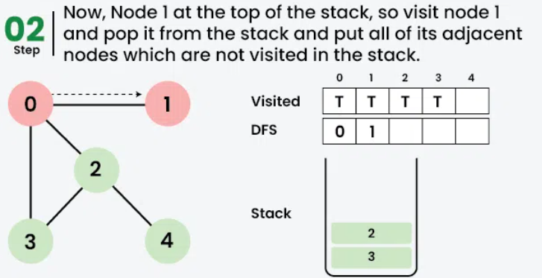
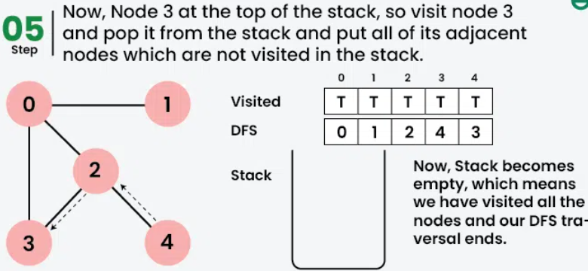
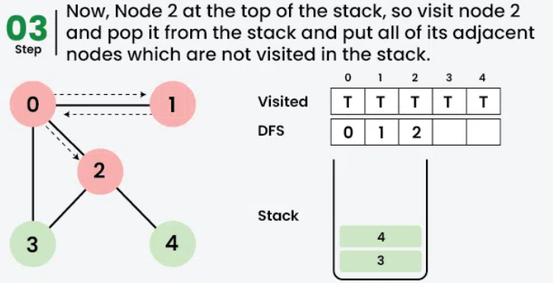
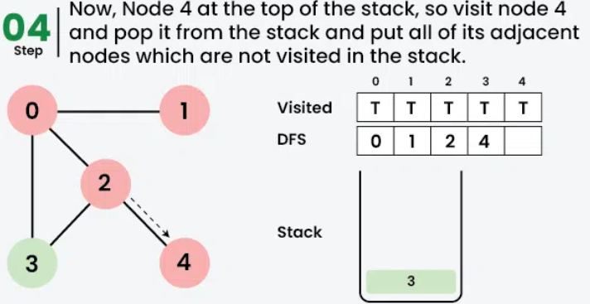
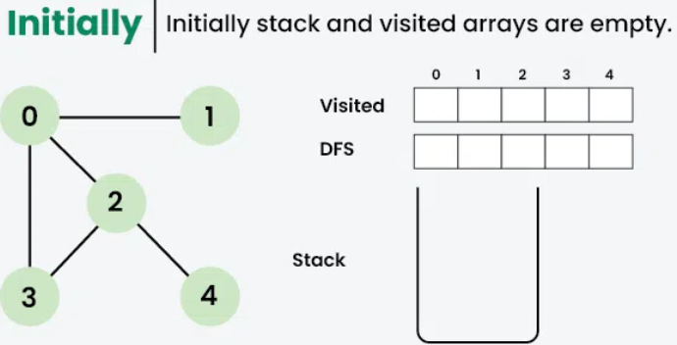
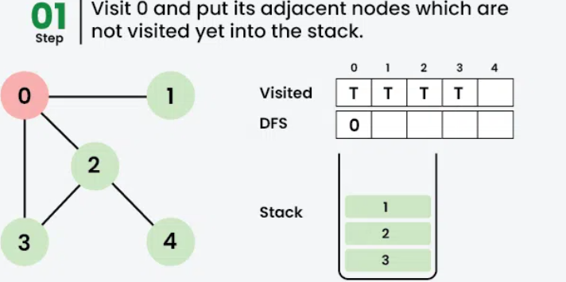
DFS

Slide 19
Complexity Analysis
Time complexity: O(V + E), Note that the time complexity is same here because we visit every vertex at most once and every edge is traversed at most once (in directed) and twice in undirected.
Auxiliary Space: O(V + E), since an extra visited array of size V is required, And stack size for recursive calls to DFSRec function.

Slide 20
Procedure : BFS (vertex V)
This procedure traverse the graph G in BFS manner
V is a starting vertex to be explored
Q is a queue
visited[] is an array which tells you whether particular vertex is visited or not
W is a adjacent node f vertex V.

Slide 21
Procedure : BFS (vertex V)
1. [Initialize Queue & Visited]
visited[] ← 0
F ← R ← 0
2. [Marks visited of V as 1]
visited[v] ← 1
3. [Add vertex v to Q]
EnQueue(V)
4. [Repeat while Q is not Empty]
Repeat while Q is not empty
v ← DeQueue()
For all vertices u adjacent to v
If visited[u] is 0
Then visited[u] ← 1
EnQueue(u)

Slide 22
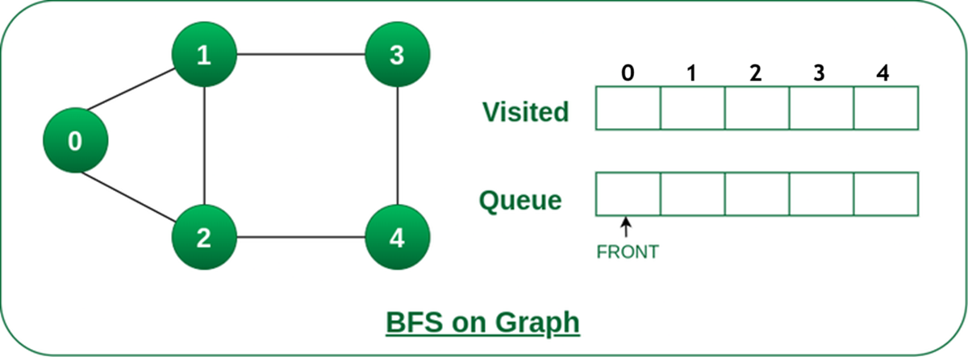
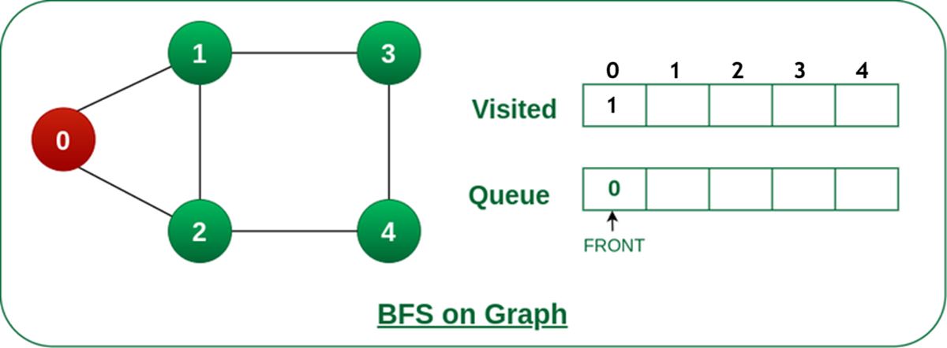
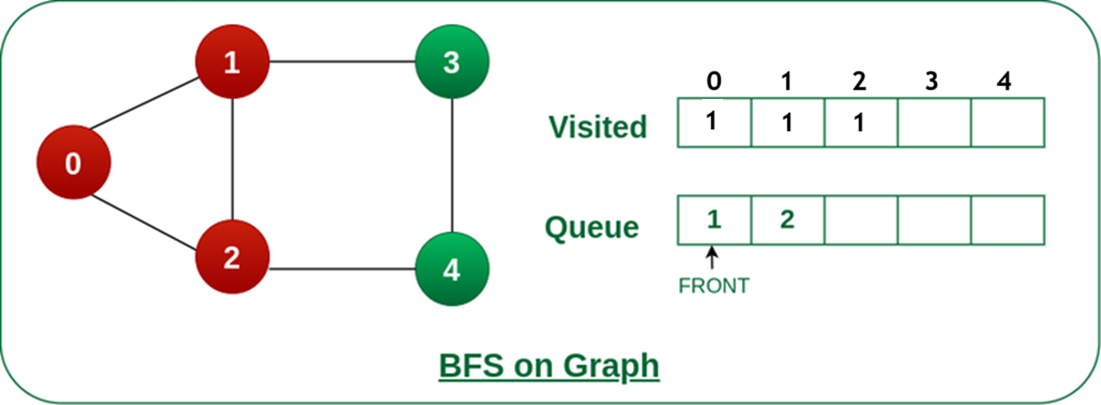
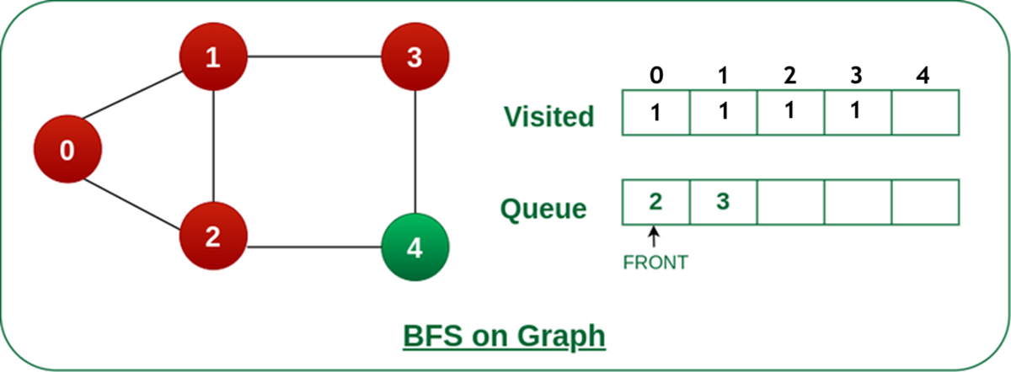
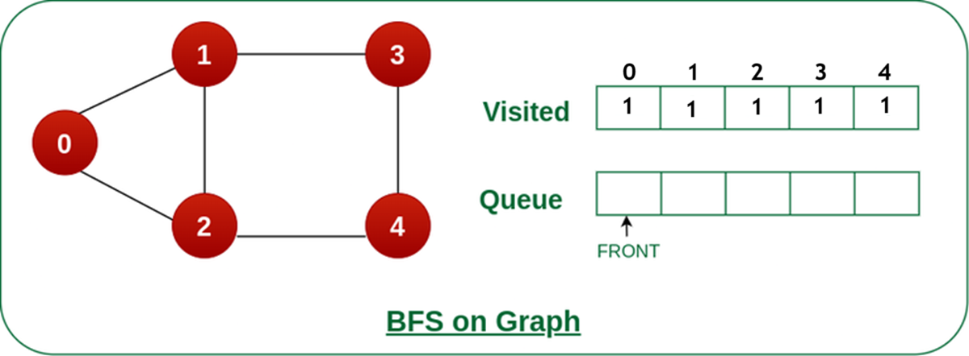
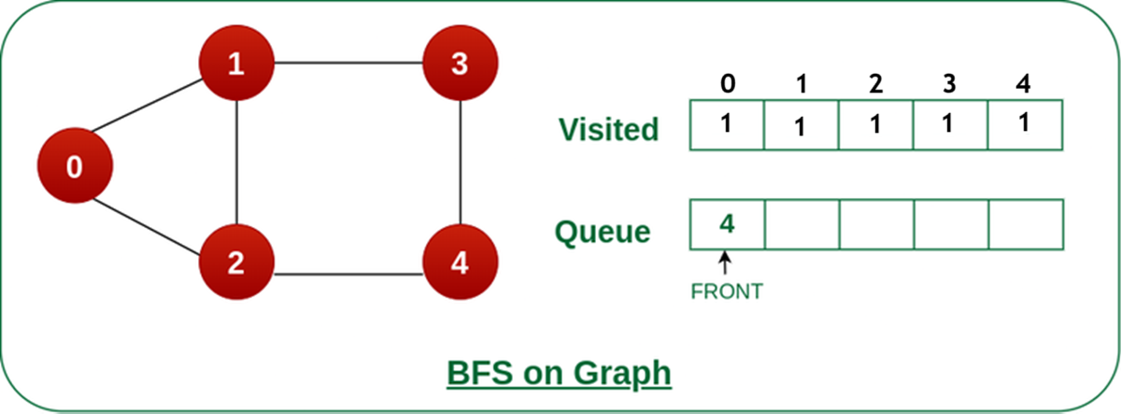
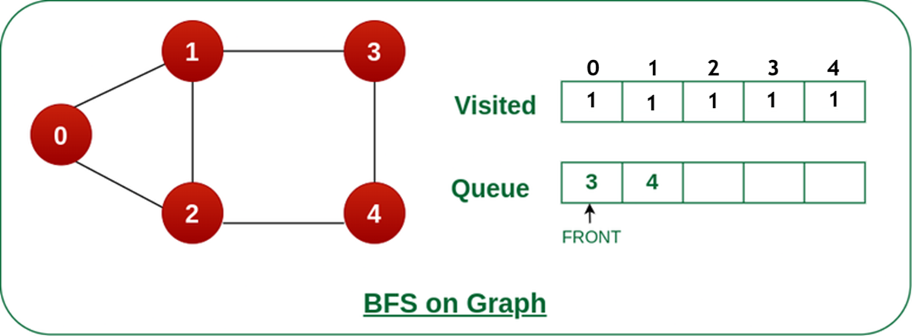
BFS

Slide 23
Complexity Analysis of Breadth-First Search (BFS) Algorithm:
Time Complexity of BFS Algorithm: O(V + E)
BFS explores all the vertices and edges in the graph. In the worst case, it visits every vertex and edge once. Therefore, the time complexity of BFS is O(V + E), where V and E are the number of vertices and edges in the given graph.
Auxiliary Space of BFS Algorithm: O(V)
BFS uses a queue to keep track of the vertices that need to be visited. In the worst case, the queue can contain all the vertices in the graph. Therefore, the space complexity of BFS is O(V).

Slide 24
Applications of BFS in Graphs:
Shortest Path Finding: BFS can be used to find the shortest path between two nodes in an unweighted graph. By keeping track of the parent of each node during the traversal, the shortest path can be reconstructed.
Cycle Detection: BFS can be used to detect cycles in a graph. If a node is visited twice during the traversal, it indicates the presence of a cycle.
Connected Components: BFS can be used to identify connected components in a graph. Each connected component is a set of nodes that can be reached from each other.
Topological Sorting: BFS can be used to perform topological sorting on a directed acyclic graph (DAG). Topological sorting arranges the nodes in a linear order such that for any edge (u, v), u appears before v in the order.
Level Order Traversal of Binary Trees: BFS can be used to perform a level order traversal of a binary tree. This traversal visits all nodes at the same level before moving to the next level.
Network Routing: BFS can be used to find the shortest path between two nodes in a network, making it useful for routing data packets in network protocols.

Slide 25
Minimum Spanning Tree

Slide 26
Spanning tree
A spanning tree is a sub-graph that connects all the vertices of a graph with the minimum possible number of edges. It may or may not be weighted and does not have cycles.
Let us understand what is spanning tree with an interesting example.
Consider a situation where a cable television network company is laying the cable to a new neighborhood. If the company is constrained to bury the cable only along certain paths for example along the roads then the problem is to find the minimum amount of cable that the company requires to complete the wiring of the television network

Slide 27
Spanning tree
A Spanning tree always contains n-1 edges, where n is the total number of vertices in the graph G.
The total number of spanning trees with complete graph of n vertices is n^{(n-2)}.
We can construct a spanning tree by removing maximum e-(n+1) edges from a complete graph G, where e is the number of edges and n is the number of vertices in graph G.

Slide 28
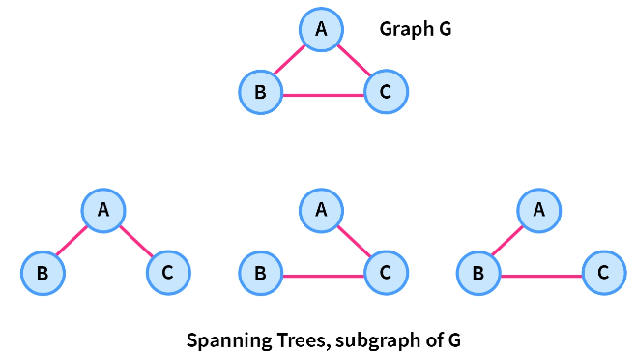
Spanning tree
A complete undirected graph G can have a maximum n^{n-2} number of spanning trees, where n is the number of nodes in a given graph G. Let us Consider a complete graph G with 3 vertices, then the total number of spanning trees this graph can have is 3⁽³⁻²⁾=3 which are shown in the image below.

Slide 29
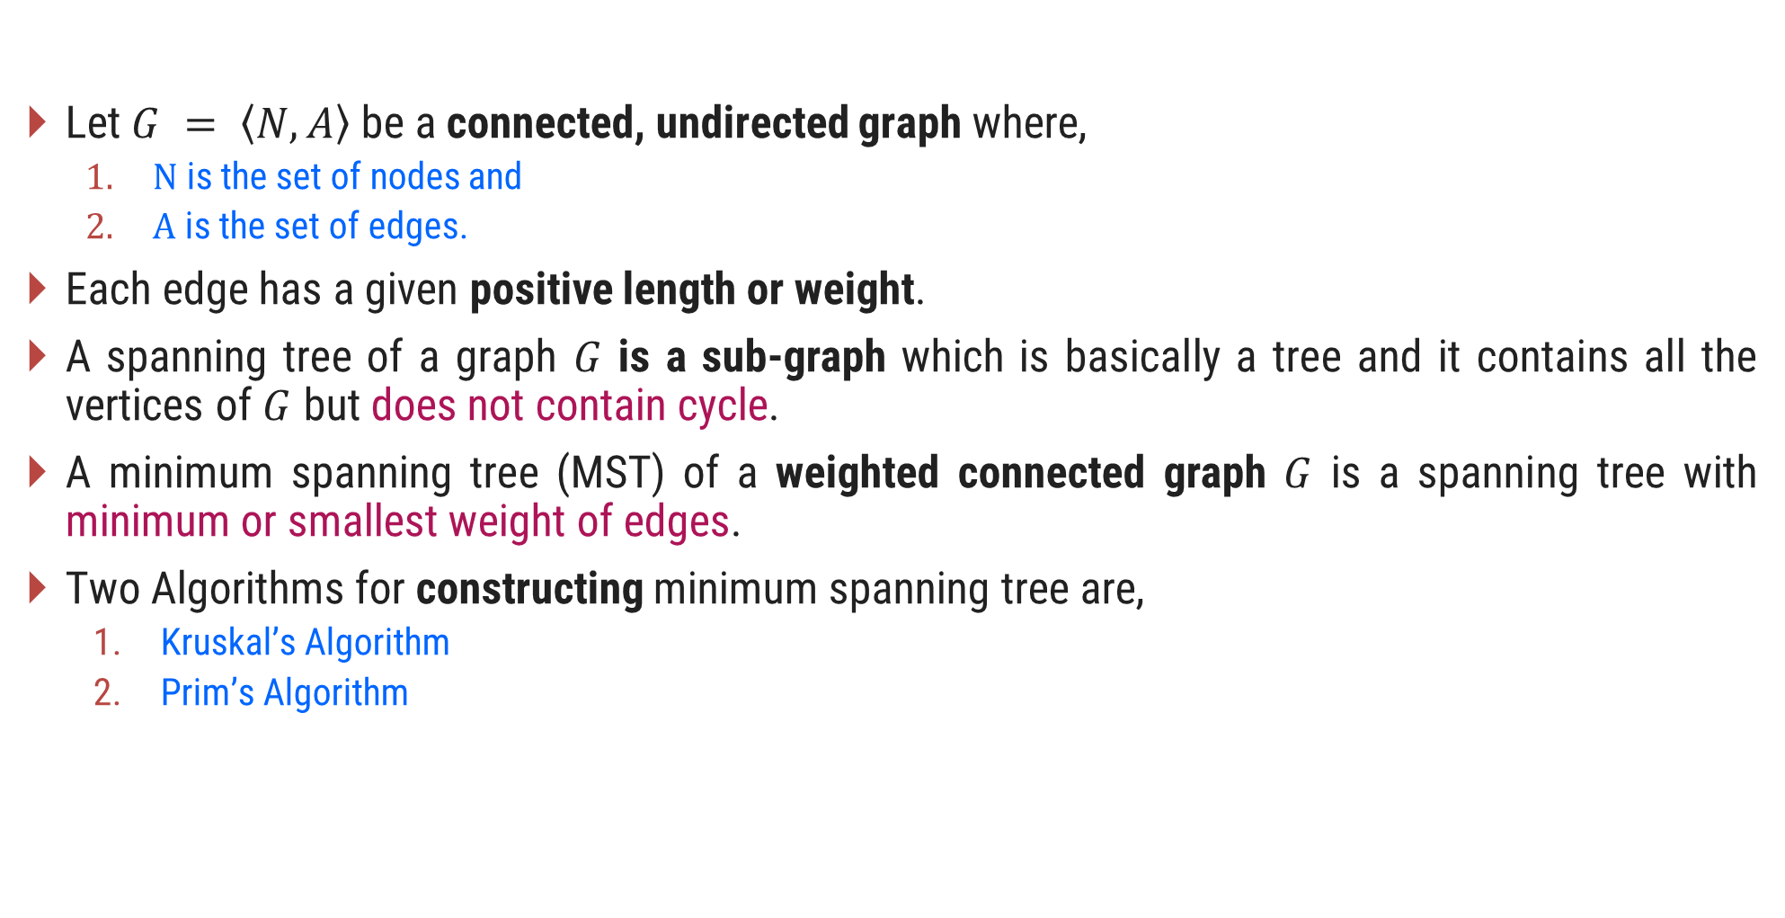
Introduction to Minimum Spanning Tree (MST)
Let $G = \left\langle N,\left.A\right\rangle \right.$be a connected, undirected graph where,
$N$ is the set of nodes and
$A$ is the set of edges.
Each edge has a given positive length or weight.
A spanning tree of a graph $G$ is a sub-graph which is basically a tree and it contains all the vertices of $G$ but does not contain cycle.
A minimum spanning tree (MST) of a weighted connected graph $G$ is a spanning tree with minimum or smallest weight of edges.
Two Algorithms for constructing minimum spanning tree are,
Kruskal’s Algorithm
Prim’s Algorithm

Slide 30
Spanning Tree Examples
Graph
A
Spanning Tree
A
B
C
B
C
D
E
F
G
D
E
F
G
H
H
Graph
Spanning Tree
A
A
B
C
E
B
C
E
D
F
D
F

Slide 31
Kruskal’s Algorithm for MST – Example 1
A
Step 2: Taking next
min edge (B,C)
4
5
Step 4: Taking next
min edge (A,B)
6
6
B
E
B
3
A
4
5
7
2
2
C
D
B
E
C
D
1
3
1
2
Step 3: Taking next
min edge (B,E)
C
D
Step 1: Taking min
edge (C,D)
B
E
1
3
So, we obtained a minimum
spanning tree of cost:
4 + 2 + 1 + 3 = 10
C
D
2
1
C
D
1

Slide 32
Kruskal’s Algorithm for MST – Example 2
Step:1
Sort the edges in increasing order of their weight.
Edges | Weight
{1, 2} | 1
{2, 3} | 2
{4, 5} | 3
{6, 7} | 3
{1, 4} | 4
{2, 5} | 4
{4, 7} | 4
{3, 5) | 5
{2, 4} | 6
{3, 6} | 6
{5, 7} | 7
{5, 6} | 8
1
1
2
2
3
4
6
4
5
6
4
5
6
3
8
7
4
3
7

Slide 33
Kruskal’s Algorithm for MST – Example 2
Step:2
Select the minimum weight edge but no cycle.
Edges | Weight
{1, 2} | 1
{2, 3} | 2
{4, 5} | 3
{6, 7} | 3
{1, 4} | 4
{2, 5} | 4
{4, 7} | 4
{3, 5) | 5
{2, 4} | 6
{3, 6} | 6
{5, 7} | 7
{5, 6} | 8
1
1
2
2
3
√
√
√
4
6
4
5
6
√
√
4
5
6
3
8
√
7
4
3
7

Slide 34
Kruskal’s Algorithm for MST – Example 2
Step:3
The minimum spanning tree for the given graph.
Edges | Weight
{1, 2} | 1
{2, 3} | 2
{4, 5} | 3
{6, 7} | 3
{1, 4} | 4
{4, 7} | 4
1
1
2
2
3
√
√
√
4
√
√
4
5
6
3
√
4
3
Total Cost = 17
7

Slide 35
Kruskal’s Algorithm – Example 2
Step | Edges considered - {u, v} | Connected Components
Init. | - | {1} {2} {3} {4} {5} {6} {7}
1 | {1,2} | {1,2} (3} {4} {5} {6} {7}
2 | {2,3} | {1,2,3} {4} {5} {6} {7}
3 | {4,5} | {1,2,3} {4,5} {6} {7}
4 | {6,7} | {1,2,3} {4,5} {6,7}
5 | {1,4} | {1,2,3,4,5} {6,7}
6 | {2,5} | Rejected
7 | {4,7} | {1,2,3,4,5,6,7}
Edges | Weight
{1, 2} | 1
{2, 3} | 2
{4, 5} | 3
{6, 7} | 3
{1, 4} | 4
{4, 7} | 4
Total Cost = 17

Slide 36
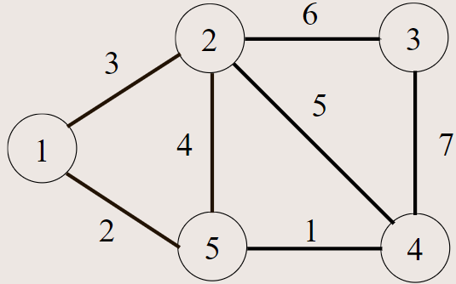
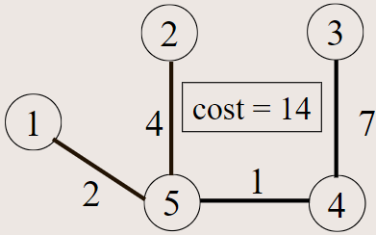

Slide 37


Exercises – Home Work
Write the kruskal’s Algorithm to find out Minimum Spanning Tree. Apply the same and find MST for the graph given below.
$$1.$$
$$2.$$
3
A
1
10
F
C
3
A
B
C
4
4
3
7
2
4
5
8
5
B
6
D
E
F
G
4
D
H
4
2
3
2
8
1
9
3
G
E
3
H

Slide 38

Prim’s Algorithm
In Prim's algorithm, the minimum spanning tree grows in a natural way, starting from an arbitrary root.
At each stage we add a new branch to the tree already constructed; the algorithm stops when all the nodes have been reached.
The complexity for the Prim’s algorithm is $θ(n^{2})$ where $n$ is the total number of nodes in the graph $G$.

Slide 39
Prim’s Algorithm for MST – Example 1
Select an arbitrary node.
Step:1
Node - Set B | Edges
1
1
1
2
2
3
4
6
4
5
6
4
5
6
3
8
7
4
3
7

Slide 40
Prim’s Algorithm for MST – Example 1
Find an edge with minimum weight.
Step:2
Node - Set B | Edges
1
1
1
2
2
3
{1, 2}, {1, 4}
4
6
4
5
6
1, 2
{1, 4}, {2, 3} {2, 4}, {2, 5}
1, 2, 3
{1,4}, {2,4}, {2,5}, {3,5}, {3,6}
4
5
6
3
8
1, 2, 3, 4
{2,4} {2,5} {3,5} {3,6} {4,5} {4,7}
7
4
3
{2,4} {2,5} {3,5} {3,6} {4,7} {5,6} {5,7}
1, 2, 3, 4, 5
7
1, 2, 3, 4, 5, 7
{2,4} {2,5} {3,5} {3,6} {5,6} {5,7} {6,7}
1, 2, 3, 4, 5, 6, 7

Slide 41
Prim’s Algorithm for MST – Example 1
Step:3
The minimum spanning tree for the given graph.
Node | Edges
1
1, 2 | {1, 2}
1, 2, 3 | {2, 3}
1, 2, 3, 4 | {1, 4}
1, 2, 3, 4, 5 | {4, 5}
1, 2, 3, 4, 5, 7 | {4, 7}
1, 2, 3, 4, 5, 6, 7 | {6, 7}
1
1
2
2
3
4
4
5
6
3
4
3
7
Total Cost = 17

Slide 42
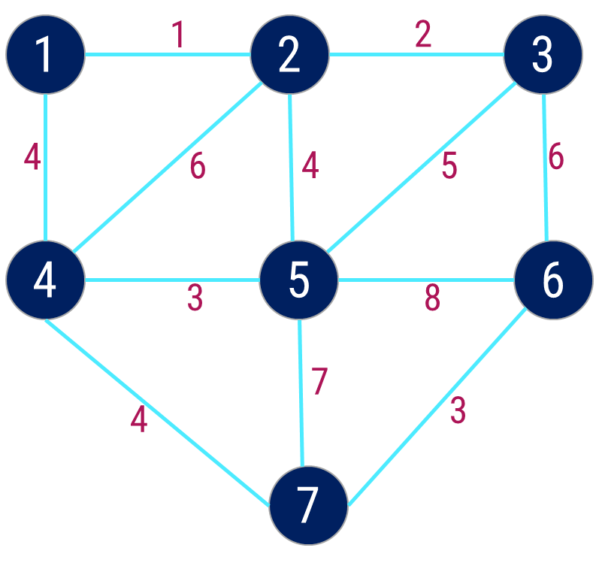
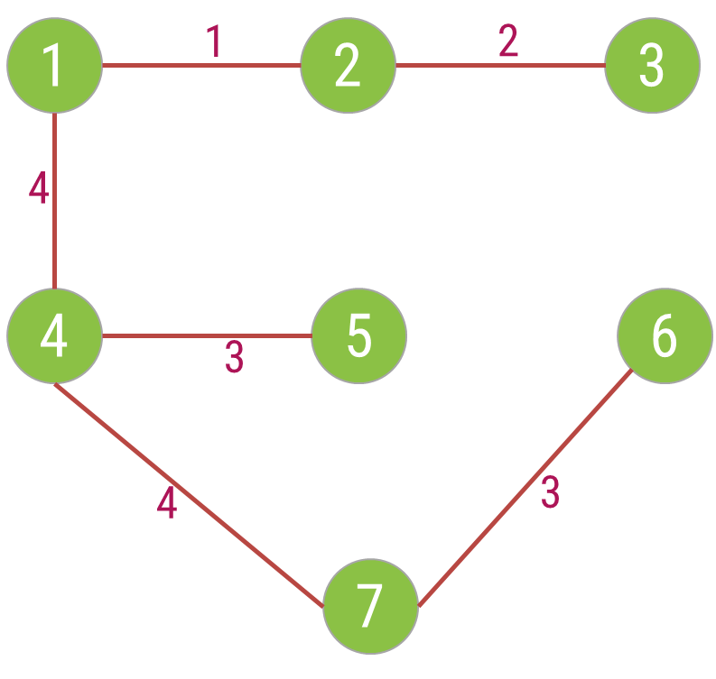
Prim’s Algorithm – Example 1
Cost = 17
Step | Edge Selected {u, v} | Set B | Edges Considered
Init. | - | {1} | --
1 | {1, 2} | {1,2} | {1,2} {1,4}
2 | {2, 3} | {1,2,3} | {1,4} {2,3} {2,4} {2,5}
3 | {1, 4} | {1,2,3,4} | {1,4} {2,4} {2,5} {3,5} {3,6}
4 | {4, 5} | {1,2,3,4,5} | {2,4} {2,5} {3,5} {3,6} {4,5} {4,7}
5 | {4, 7} | {1,2,3,4,5,7} | {2,4} {2,5} {3,5} {3,6} {4,7} {5,6} {5,7}
6 | {6,7} | {1,2,3,4,5,6,7} | {2,4} {2,5} {3,5} {3,6} {5,6} {5,7} {6,7}

Slide 43


Exercises – Home Work
Write the Prim’s Algorithm to find out Minimum Spanning Tree. Apply the same and find MST for the graph given below.
$$1.$$
$$2.$$
3
A
1
10
F
C
3
A
B
C
4
4
3
7
2
4
5
8
5
B
6
D
E
F
G
4
D
H
4
2
3
2
8
1
9
3
G
E
3
H

Slide 44
Construct Spanning Tree
A
A
A
B
C
B
C
B
C
D
E
F
G
D
E
F
G
D
E
F
G
H
H
H
DFS Spanning Tree
BFS Spanning Tree
A
A
A
B
C
E
B
C
E
B
C
E
D
F
D
F
D
F
DFS Spanning Tree
BFS Spanning Tree

Slide 45
Minimum Cost Spanning Tree
The cost of a spanning tree of a weighted undirected graph is the sum of the costs(weights) of the edges in the spanning tree
A minimum cost spanning tree is a spanning tree of least cost
Two techniques for Constructing minimum cost spanning tree
Prim’s Algorithm
Kruskal’s Algorithm

Slide 46
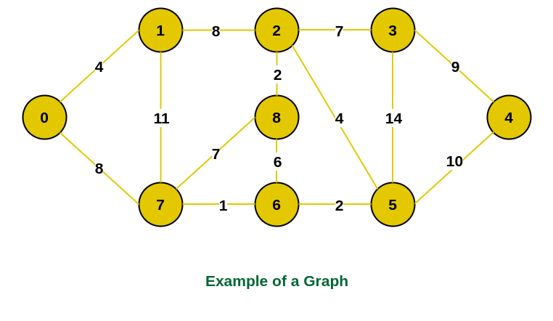
Example:

Slide 47
Shortest Path Algorithm
Let G = (V,E) be a simple diagraph with n vertices
The problem is to find out shortest distance from a vertex to all other vertices of a graph
Dijkstra Algorithm – it is also called Single Source Shortest Path Algorithm

Slide 48
Dijkstra Algorithm – Shortest Path
2
B
D
1
6
A | B | C | D | E | F
0 | ∞ | ∞ | ∞ | ∞ | ∞
0 | 0 | 0 | 0 | 0 | 0
0
A
1
4
7
F
Distance
5
2
Visited
C
E
5
1st Iteration: Select Vertex A with minimum distance
1
∞
2
A | B | C | D | E | F
0 |  |  | ∞ | ∞ | ∞
 |  |  | 0 | 0 | 0
B
D
∞
1
6
1
5
Distance
∞
∞
4
F
0
A
1
7
Visited
A
0
0
5
2
C
E
5
5
∞

Slide 49
Dijkstra Algorithm – Shortest Path
2nd Iteration: Select Vertex B with minimum distance
Cost of going to C via B = dist[B] + cost[B][C] = 1 + 1 = 2
A | B | C | D | E | F
0 | 1 | 5 | ∞ | ∞ | ∞
A | A | 0 | 0 | 0 | 0
Cost of going to D via B = dist[B] + cost[B][D] = 1 + 2 = 3
Distance
Cost of going to E via B = dist[B] + cost[B][E] = 1 + 4 = 5
Visited
Cost of going to F via B = dist[B] + cost[B][F] = 1 + ∞ = ∞
1
3
2
B
D
6
1
0
A
1
4
7
F
∞
A | B | C | D | E | F
0 | 1 | 2 | 3 | 5 | ∞
 |  |  | 0 | 0 | 0
5
2
Distance
5
C
E
A
A
0
Visited
2
5

Slide 50
Dijkstra Algorithm – Shortest Path
3rd Iteration: Select Vertex C via B with minimum distance
Cost of going to D via C = dist[C] + cost[C][D] = 2 + ∞ = ∞
A | B | C | D | E | F
0 | 1 | 2 | 3 | 5 | ∞
A | A | B | 0 | 0 | 0
Cost of going to E via C = dist[C] + cost[C][E] = 2 + 5 = 7
Distance
Cost of going to F via C = dist[C] + cost[C][F] = 2 + ∞ = ∞
Visited
1
3
2
B
D
6
1
0
A
1
4
7
F
A | B | C | D | E | F
0 | 1 | 2 | 3 | 5 | ∞
 |  |  | 0 | 0 | 0
5
2
∞
Distance
5
C
E
Visited
A
A
B
2
5

Slide 51
Dijkstra Algorithm – Shortest Path
4th Iteration: Select Vertex D via path A - B with minimum distance
Cost of going to E via D = dist[D] + cost[D][E] = 3 + 7 = 10
A | B | C | D | E | F
0 | 1 | 2 | 3 | 5 | ∞
A | A | B | 0 | 0 | 0
Cost of going to F via D = dist[D] + cost[D][F] = 3 + 6 = 9
Distance
Visited
1
3
2
B
D
6
1
A
1
4
7
F
5
A | B | C | D | E | F
0 | 1 | 2 | 3 | 5 | 9
 |  |  | 1 | 0 | 0
2
9
5
Distance
C
E
Visited
A
A
B
2
5

Slide 52
Dijkstra Algorithm – Shortest Path
4th Iteration: Select Vertex E via path A – B – E with minimum distance
Cost of going to F via E = dist[E] + cost[E][F] = 5 + 2 = 7
A | B | C | D | E | F
0 | 1 | 2 | 3 | 5 | 9
A | A | B | 1 | B | 0
Distance
Visited
1
3
2
B
D
6
1
A | B | C | D | E | F
0 | 1 | 2 | 3 | 5 | 7
 |  |  | B | B | E
A
1
4
7
F
7
5
Distance
2
Visited
A
A
B
C
E
2
5
Shortest Path from A to F is
A → B → E → F = 7

Slide 53
Shortest Path
Find out shortest path from node 0 to all other nodes using Dijkstra Algorithm
0
0
100
0
100
10
10
60
10
30
4
30
4
1
1
60
60
50
10
50
10
2
3
2
3
20
50
20
30

